Slide 1

Automatically Populating an Ontology by using a ProCyclingStats scraper
Semantic Web Technology
Project Proposal
#JodyBernal 🦄

Slide 2

ProCyclingStats
DB for cycling data
Contains data on
Races
Teams
Cyclists

Slide 3
Approach
Classes:
Rider
Team
Sponsor
Object Properties:
Has_Rider
Rides_For
Sponsors
Sponsored_By
Data Properties:
First_Name
Last_Name
Weighs
From_Country
Official_Team_Name

Slide 4
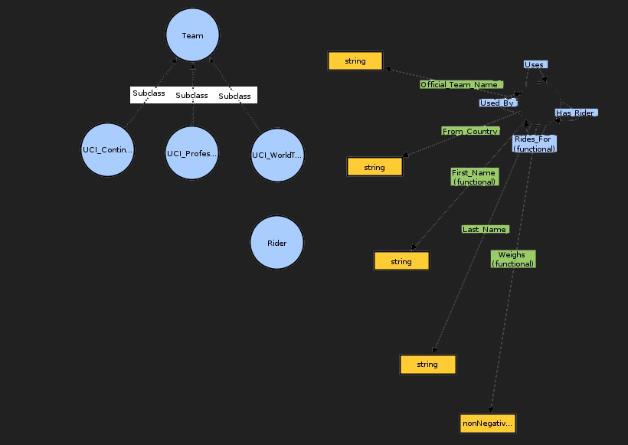
Notes:
Used_By wordt bij ons Sponsored_By
Uses wordt Sponsors

Slide 5
Techniques and Tools
Scraper
BeautifulSoup
RDFLib
DBpedia
Baseline performance

Slide 6
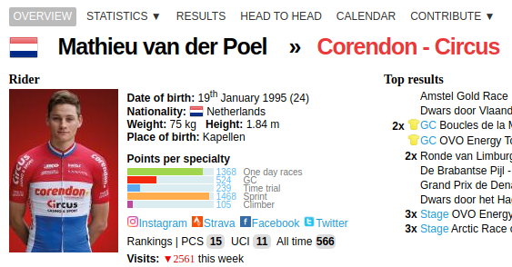
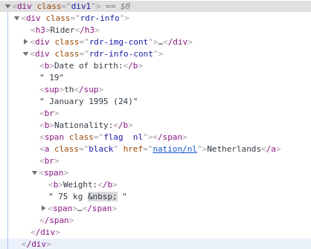

Slide 7
Retrieving DBpedia information
Wikipedia
articles (concepts)
redirect pages (synonyms)
disambiguation pages (homonyms)
hyperlinks (polysemy)
category (acyclic graph)
Information boxes
Semantic web
SPARQL

Slide 8
DBpedia dump
Find most frequent resource of cyclist
Retrieve DBpedia resource of cyclist
Make SPARQL-query
Retrieve information
Create ontology

Slide 9

Summary
ProCyclingStats ontology
Scraper
DBpedia ontology
Baseline
Comparison

